Slide 1

INFO 5100
SUPPLY CHAIN MANAGEMENT IN HEALTH CARE
Team No: 44
Sai Guna Vardhan Vudatala - 00201897
Varun Teja Kalakoti - 002050659
Hotragn Pettugani - 002301712
Application Engineering and Development
Final Project Presentation

Slide 2

Problem Statement
The healthcare supply chain leads to treatment delays, shortages, and ineffective communication among stakeholders, compromising patient care. This project aims to establish an integrated communication system to streamline coordination and improve supply chain efficiency.

Slide 3
Deliverables
The primary deliverables include advanced feature introduction:
1 Network, 5 Enterprises, 10 Organizations, and 10 Roles
A unified data management platform
Real-time inventory tracking system
Stakeholder collaboration framework
Emergency response protocols
Supply chain visibility dashboard
These solutions will enhance operational efficiency, reduce supply shortages, and ultimately improve patient care outcomes through better supply chain coordination.

Slide 4
Stake Holder Contributions
1. Hospital Management
Patient Services: Manage patient records, appointments, and healthcare history.
Doctor Interaction: Facilitate patient-doctor consultations, prescriptions, and diagnoses.
Feedback Management: Collect and analyze patient feedback for service improvement.
Healthcare Operations: Oversee administrative tasks and service quality.
2. Pharmacy
Drug Inventory Management: Track availability, storage, and sales of medications.
Prescription Handling: Fulfill prescriptions provided by doctors within the system.
Customer Services: Assist patients in obtaining medications and provide drug-related information.
Drug Requests: Manage incoming requests from hospitals and patients.
3. Laboratory (Lab Diagnostics)
Lab Services: Conduct medical tests and provide results for diagnosis.
Sample Management: Ensure proper handling, storage, and processing of test samples.
Reporting: Generate and share diagnostic reports with healthcare providers and patients.
.

Slide 5
Stake Holder Contributions
4. Blood Donation Organizations
Collect blood donations from volunteers.
Process and test blood to ensure safety.
Store blood products under appropriate conditions.
Distribute blood to hospitals and healthcare facilities as needed.
5. Research Institutions:
Collaborate with pharmaceutical companies to design and conduct clinical trials.
Analyze clinical trial data.
Contribute to research and development of new treatments.
6. Quality Management Team
Monitor and improve service quality
Analyze patient feedback and satisfaction metrics
Implement quality improvement initiatives
Ensure compliance with healthcare standards

Slide 6
How each enterprise is essential to delivering the total value as outlined in our problem statement
Logistics Company Enterprise
Critical Value: Enables efficient distribution and inventory management
Key Contributions:
Coordinates medical supply transportation through TransportOrganization
Optimizes inventory levels via InventoryManagementOrganisation
Ensures timely delivery through TransportationCoordinationRequest
Prevents stockouts through real-time inventory tracking
Healthcare Enterprise
Critical Value: Delivers direct patient care and manages medical resources
Key Contributions:
Coordinates patient care through HospitalAdministrationOrganization
Manages clinical operations via ClinicalOrganization
Initiates supply requests based on patient needs
Provides critical feedback on drug efficacy
Pharmaceutical Manufacturer Enterprise
Critical Value: Ensures reliable drug production and quality control
Key Contributions:
Manages drug production through DrugProductionOrganization
Ensures medication safety via QualityControlAndAssuranceOrganization
Responds to urgent supply needs with DrugAvailabilityNotificationRequest
Maintains quality standards through rigorous testing protocols
Logistics Company Enterprise

Slide 7
How each enterprise is essential to delivering the total value as outlined in our problem statement
Research and Development Enterprise
Critical Value: Drives innovation and improvement in healthcare
Key Contributions:
Conducts research through ChemicalCompoundResearchOrganization
Manages clinical trials via ClinicalTrialsManagementOrganization
Develops new treatments and therapies
Validates drug effectiveness through clinical studies
Blood Donation Enterprise
Critical Value: Maintains vital blood supply chain management
Key Contributions:
Collects blood through BloodCollectionOrganization
Processes and stores blood via BloodProcessingAndStorageOrganization
Responds to urgent blood requests
Ensures blood safety and availability
Integration Benefits​
Real-time communication between enterprises​
Streamlined workflow management​
Enhanced patient care through coordinated efforts​
Improved resource allocation and utilization​
Reduced delays and inefficiencies​
Better emergency response capabilities​
This integrated approach ensures that each enterprise contributes its specialized expertise while working together to solve the complex challenges in healthcare supply chain management.​​
​​

Slide 8
Design and Implementation Techniques
2. Design Patterns Implemented
Creational Patterns
Singleton Pattern (EcoSystem)
Factory Method (Organization creation)
Builder Pattern (WorkRequest construction)
Adapter (Role implementations)
Behavioral Patterns
Observer (Status updates)
Strategy (Request handling)
Template Method (WorkRequest processing)
1. Architectural Patterns
Model-View-Controller (MVC)
Model: Business logic in Organization and Enterprise classes
View: User interface panels for each role
Controller: Role-based workflow management
Layered Architecture
Presentation Layer: User interfaces
Business Layer: Work request processing
Data Layer: Directory management

Slide 9
Design and Implementation Techniques
3. Object-Oriented Principles
Encapsulation
Private attributes with public getters/setters
Protected internal operations
Data validation within classes
Inheritance
Abstract base classes (Organization, Role, WorkRequest)
Polymorphism
Role-specific implementations
Request type variations
4. Implementation Techniques
Security
Role-based access control
Password hashing
Session management
Data Management
Directory structures
Data validation
Error Handling
Request validation

Slide 10
Design and Implementation Techniques
5. Code generation
Code Organization
Package Structure
Enterprise-level packages
Organization-specific components
Role-based implementations
Workflow management
Modularity
Independent components
Loose coupling
High cohesion
6. Best Practices
Code Quality
Clear naming conventions
Consistent documentation
Code reusability
Performance
Efficient data structures
Optimized algorithms
Resource management
Maintainability
Modular design

Slide 11
UML
Link to diagram

Slide 12
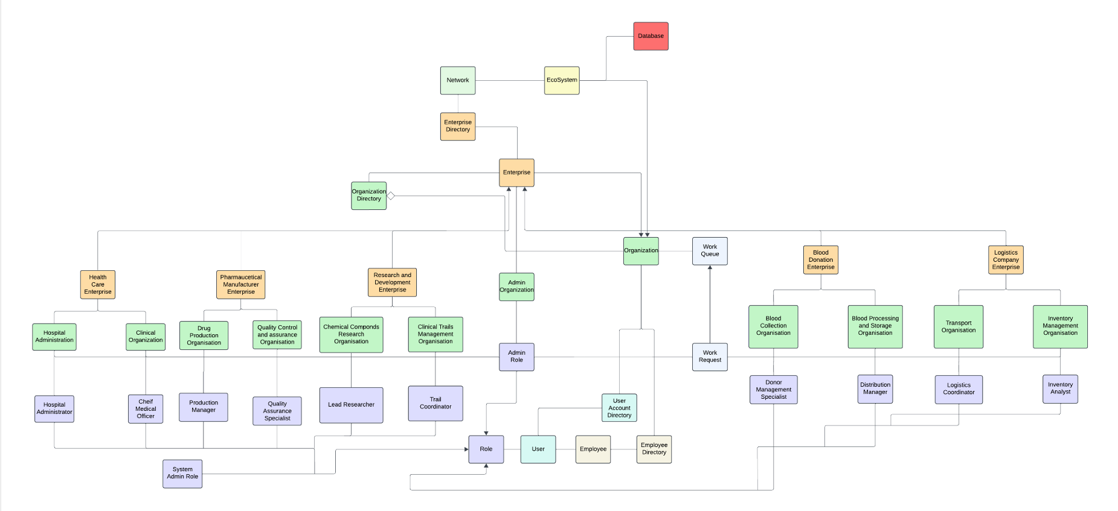
High-Level Component Diagram

Slide 13
Use Cases
Easy Use Case: Blood Supply Request
Actor: Hospital Administrator
Preconditions:
User has valid system credentials
User has Hospital Administrator role
Basic Flow:
Administrator logs into the system
Navigates to Blood Supply Management section
Creates new blood supply request
Enters required details:
Blood type
Quantity needed
Delivery location
Required date
Submits request
System confirms request creation
Post-conditions:
Blood supply request is logged in system
Blood Donation Organization receives notification
Medium Use Case: Drug Efficacy Feedback
Actor: Clinical Organization Nurse
Basic Flow:
Nurse logs into system
Selects drug efficacy feedback option
Enters drug details:
Drug name
Batch number
Efficacy rating
Patient symptoms improvement
Submits feedback report
System forwards to Quality Control
Alternate Flow A: Adverse Effects Reported
Nurse marks serious side effects
System triggers urgent notification
Quality Control team is immediately alerted
Pharmaceutical manufacturer receives priority notification
Post-conditions:
Feedback recorded in system
Quality metrics updated
Manufacturer receives efficacy data
Heavy Use Case: Emergency Blood Transportation
Actor: Transport Coordinator, Blood Bank Manager, Hospital Administrator
Preconditions:
Valid emergency protocol activation
Available blood supply confirmed
Transport vehicles available
Basic Flow:
Hospital initiates urgent blood request
Blood bank confirms availability
Transport coordinator:
Assigns nearest vehicle
Plans optimal route
Sets temperature controls
Dispatches transport
Alternate Flows:
Supply Shortage:
System checks alternate blood banks
Reroutes from multiple locations
Updates all stakeholders
Transport Issues:
Activates backup transport
Recalculates delivery time
Notifies hospital of delays
Post-conditions:
Blood delivery tracked in real-time
Temperature logs maintained
Delivery confirmation recorded
Inventory automatically updated

Slide 14
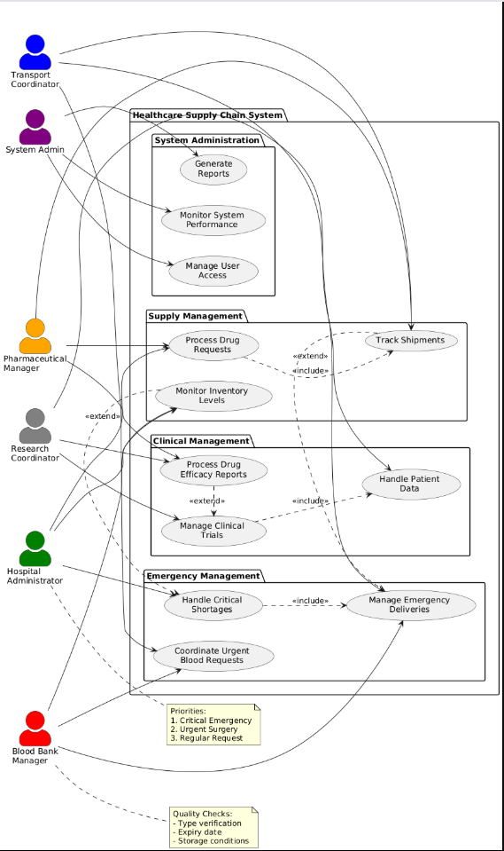
Use Case Diagram

Slide 15
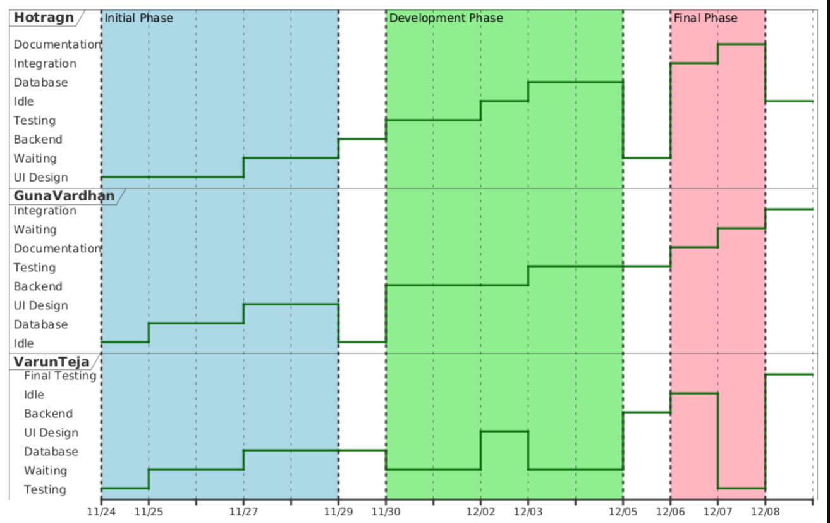
Individual Contributions

Slide 16
Conclusion and Future Scope
Scalability Enhancements:
Adopt advanced cloud services for better scalability.
Utilize microservices for flexible system growth.
Advanced Analytics:
Introduce predictive analytics for market insights.
Use machine learning for decision-making efficiency.
User Experience (UX) Improvements:
Update the UI based on user feedback for improved accessibility.

Slide 17
Thank You

